Slide 1



SHIPPING CODE WITH DOKKU
Shipping Code with Dokku by @shirkey is licensed under a Creative Commons Attribution 4.0 International License.
Jakarta, Indonesia
8 Mar 2014 / @shirkeydev
http://bit.ly/dokku-2014-03

Slide 2
Topics
Assumptions about me, about you, about scope
Dokku Overview describes Dokku and the toolset
Dokku Applied illustrates how Dokku can help you
App Deploy aka “throwing things over the wall”
Dokku Walkthrough hands-on with Dokku
App Deploy Reloaded with the help of Dokku
Resources to start now with Dokku
Notes:
* context
* quick 50k ft view, Dokku and tools
* what does this mean to me
* leave

Slide 3
1
ASSUMPTIONS

Slide 4
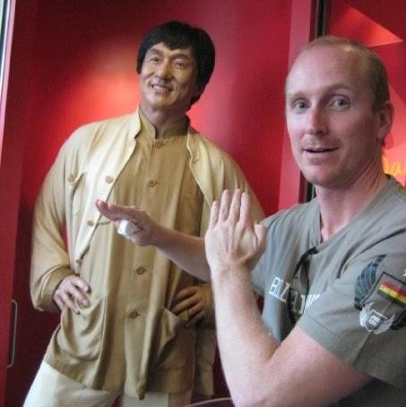
@shirkeydev
20 years tech experience
Network/Ops
Development
Project Mgmt
8 years in Indonesia
4 weeks using Dokku!
@shirkeydev != “Dokku Ninja”
Notes:
20/8 technical
4 weeks = #NoNinja!

Slide 5



@<you>
@bizowner
@sysadmin
@developer
mix and match -- maybe you are all three!
Notes:
*who is in the room: developers, ops, entrepeneurs?
* the next Bill G
* or Edward Snowden
* heads-down developer * dokku use case different aspects * you will profit

Slide 6
Scope
Dokku -- not Docker itself
Quick walkthrough
Not a technical deep-dive
… but walkthrough code will be available
Get you up-and-running with Dokku today
Notes:
* Focus on Dokku, not Docker
* Quick walkthrough of key Dokku commands, perform simple end-to-end app dev and deployment
* Meetups diverse audience, not everyone is technical
* Source code will be available at the end
* finally, motivate you to learn more about this, save yourself some valuable time

Slide 7
2
DOKKU OVERVIEW

Slide 8

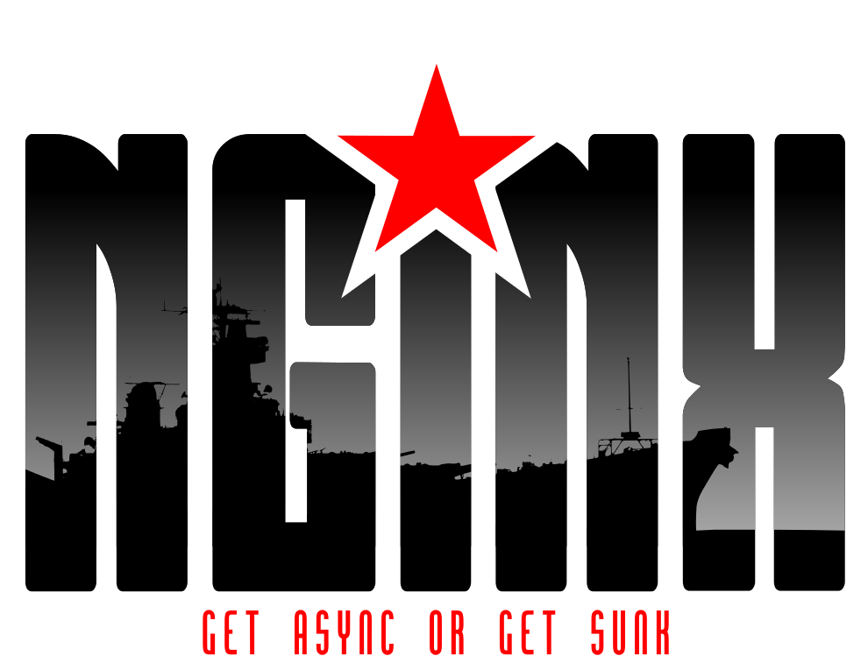

@<you>
DOKKU
BUILDPACKS
DOKKU: THE TOOLSET
Notes:
dokku is a wrapper around well-tested tools within a well-tested paradigm
* git version control
* docker containers
* heroku-like deployment
* nginx web services

Slide 9
Git
distributed version control
integrates with your use case
widespread industry adoption
created by Linus Torvalds
“[A] version control system designed [for] speed and efficiency”
from http://git-scm.com/
Notes:
* free/open source
* with or without a dedicated server
* offline or online
* adaptable to your use case
* excellent pedigree

Slide 10
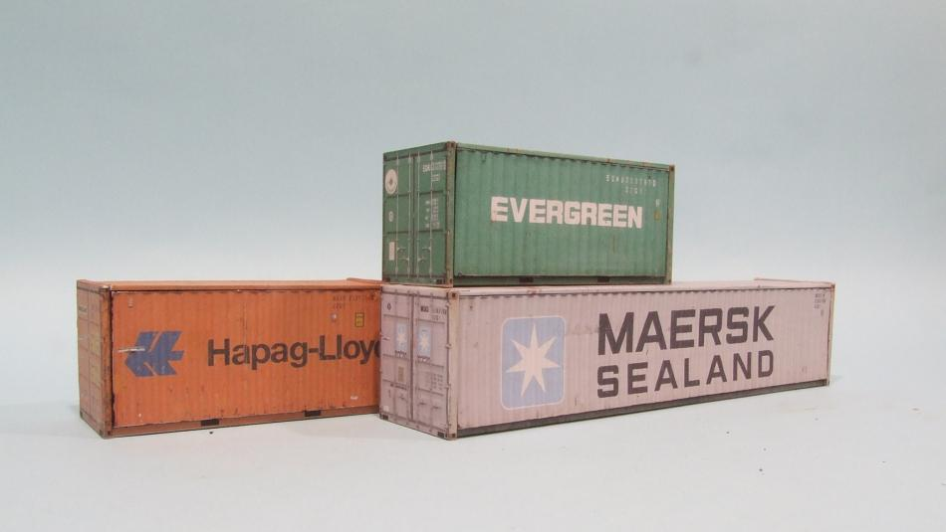
Docker
CONTAINERS,
CONTAINERS,
CONTAINERS!
Notes:
* Docker, lightweight containers
* repeatable deployment for your app

Slide 11
Docker
NOT YET PRODUCTION
CONTAINERS,
CONTAINERS,
CONTAINERS!
Notes:
danger!

Slide 12
Heroku
Platform-as-a-Service (PaaS)
Free tier, optionally scales up to meet your demand
Easy deployment via git
Services (database, email, etc) all available in the same integrated platform
Limits to size and scale of the application on the free tier
“Cloud computing designed and built for developers”
from http://heroku.com
Notes:
Heroku great starter
integration to dev env via git
well-tested paradigm for app deployment

Slide 13
Nginx
reverse proxy to apps
forwards requests by application name
custom config can be added without affecting Dokku
“nginx (engine x) is an HTTP and reverse proxy server...”
from http://nginx.org
Notes:
nginx = swiss army knife of http request handling

Slide 14
Dokku
114 lines of Bash
Heroku conventions
Git for code deployment
Docker for virtualization, isolation
Plugins (Postgres, Redis, etc)
Single server only (see flynn.io)
“Docker powered mini-Heroku. The smallest PaaS implementation you've ever seen.” from http://github.com/progrium/dokku
Notes:
Heroku conventions: commands, git deployment, setting env vars
Docker: maturing platform for lightweight virtualization and application isolation Git: Rebuild application’s Docker images with each git push

Slide 15
Dokku
“Docker powered mini-Heroku. The smallest PaaS implementation you've ever seen.” from http://github.com/progrium/dokku
114 lines of Bash
Heroku conventions
Plugins (Postgres, Redis, etc)
Docker for virtualization, isolation
Git for code deployment
NOT YET PRODUCTION
Notes:
danger!

Slide 16
3
DOKKU APPLIED

Slide 17
@bizowner
@sysadmin
@developer
@<you> + DOKKU = #PROFIT
Notes:
simple formula

Slide 18
@bizowner
“What can Dokku do for our bottom line?”
increased efficiency
sysadmins focus on production
no vendor lock-in
hosting internal or external
implementation flexibility
multiple codebase versions
language agnostic
@bizowner
Notes:
for entrepreneurs:
more done for less: focus sysadmins on production tasks

Slide 19
@sysadmins
“How does Dokku make my life easier?”
polyglot apps run side-by-side
Ruby, Python, Node, etc
consistent deployment
configuration controlled by git repository
Heroku interface, Docker core
one base image
configurable buildsteps
@sysadmin
Notes:
for sysadmins:
out of the box, it gives you the ability to sandbox any number of languages on a single server -- Ruby, Python, Node, etc. all supported, and further extension can be made via

Slide 20
@developers
“How will Dokku change my workflow?”
build it your way
Ruby, Python, Node, etc.
deploy via git push
source from any branch
choose one or more targets
example: dev, stage, uat
@developer
Notes:
for sysadmins:
out of the box, it gives you the ability to sandbox any number of languages on a single server -- Ruby, Python, Node, etc. all supported, and further extension can be made via

Slide 21
4
APP DEPLOY

Slide 22

2
LIFE BEFORE DOKKU

Slide 23
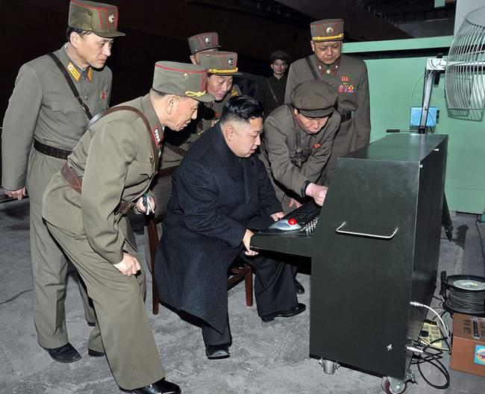

Notes:
so you have shown your code to everyone on your laptop, and everyone loves it -- and now you are ready to deploy… everything is great!

Slide 24
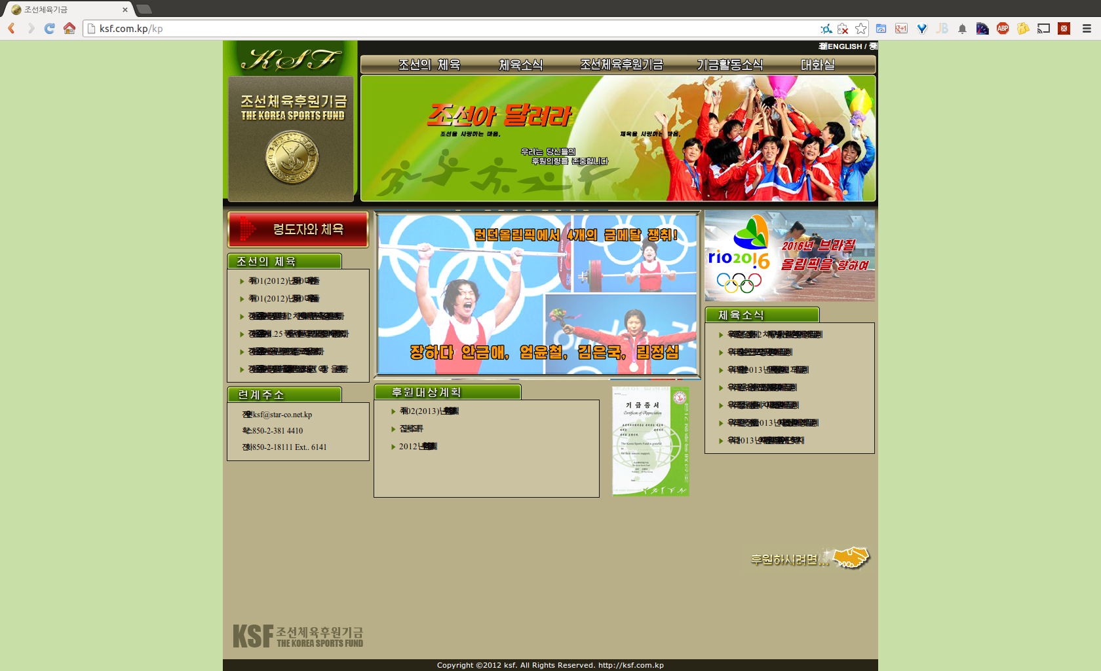
APPROVED!

Slide 25
Notes:
wait a minute, what’s this? enhance!

Slide 26
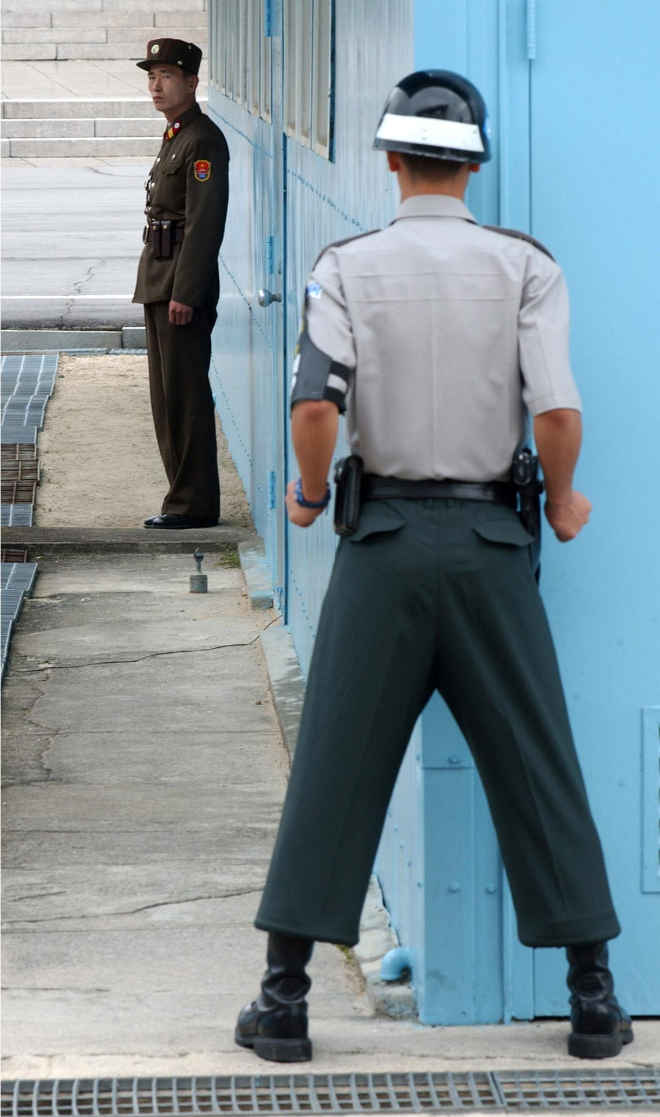
DEV LAND
OPS LAND
DMZ
Notes:
in the ideal world, this is a simple push operation, packaging and moving the code through a series of tests and finally arriving as a deployable package in OpsLand in reality, it is a series of skirmishes consisting of several back-and-forth
trips between dev and ops

Slide 27
DEV LAND
OPS LAND
DMZ
Notes:
in the ideal world, this is a simple push operation, packaging and moving the code through a series of tests and finally arriving as a deployable package in OpsLand in reality, it is a series of skirmishes consisting of several back-and-forth
trips between dev and ops

Slide 28
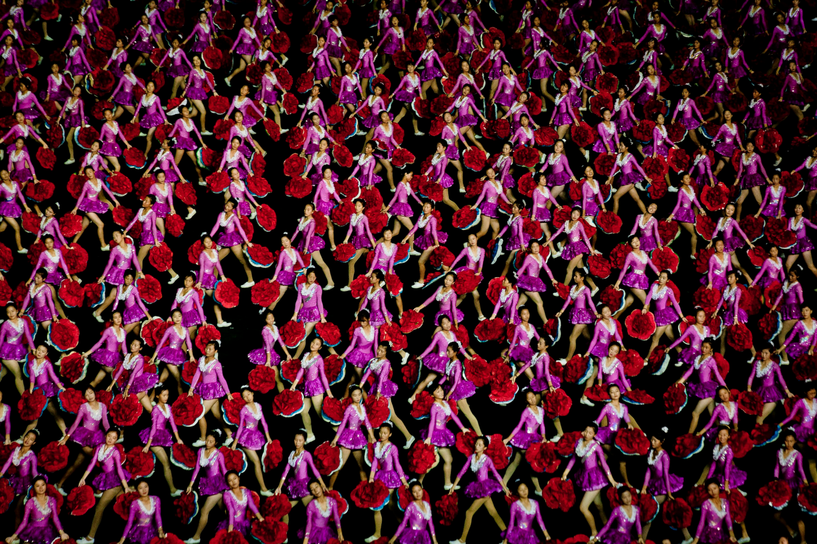
LAUNCH DAY

Slide 29
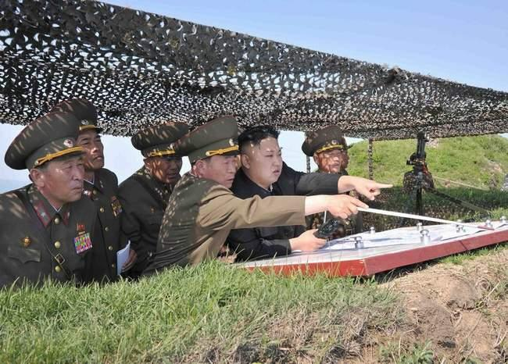
DEPLOY!
Notes:
it’s launch day! DEPLOY!

Slide 30
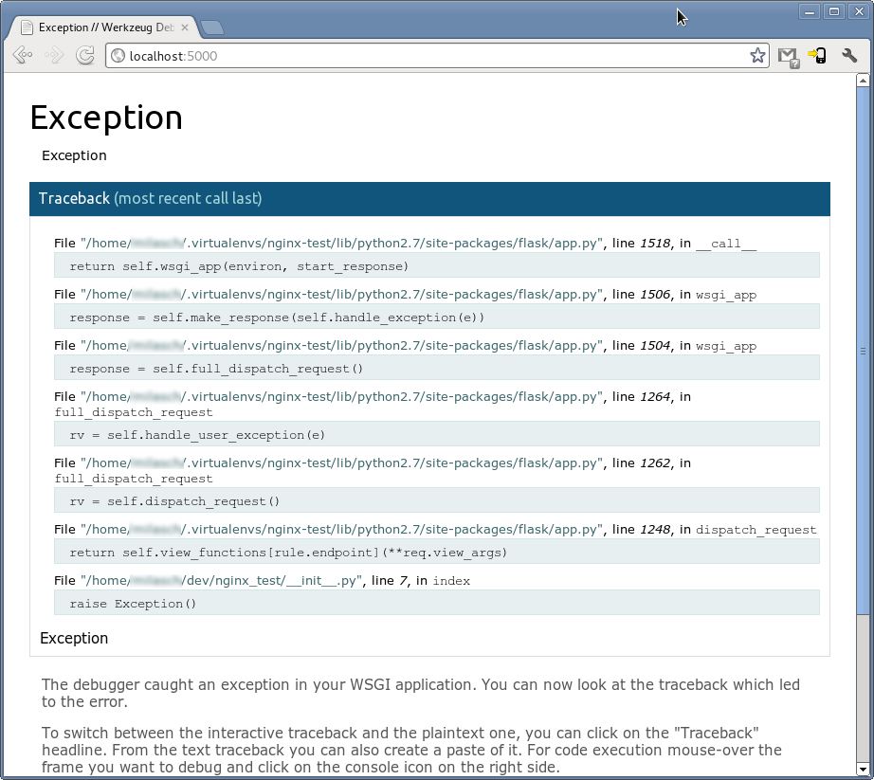

Slide 31

#FAIL

Slide 32
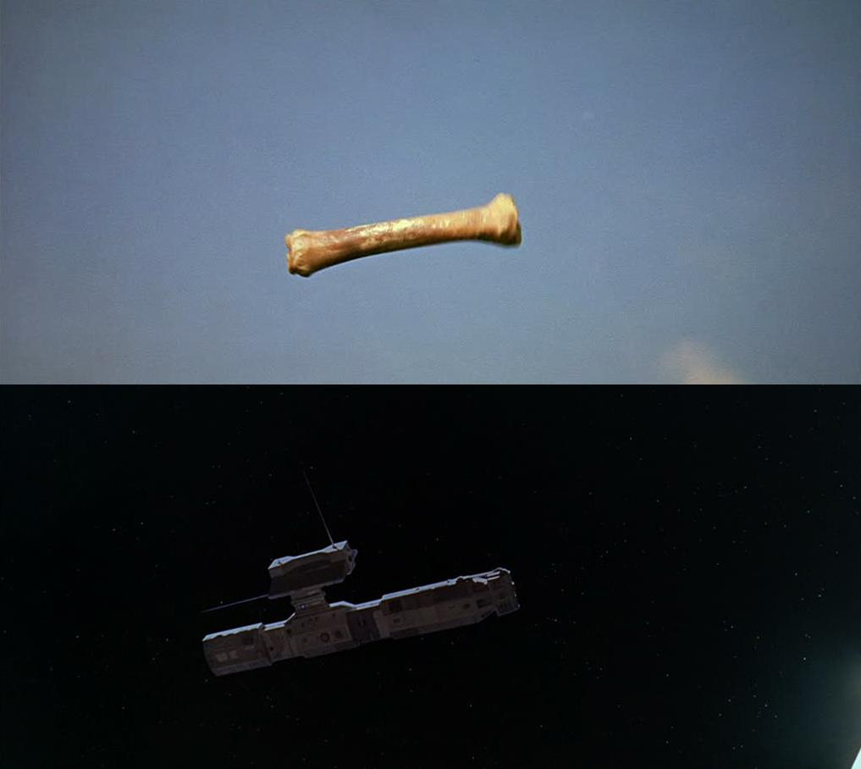
so how do we get from here...
to here?

Slide 33
5
DOKKU WALKTHROUGH

Slide 34

DOKKU AUTOMATES
SHIPMENTS
OF YOUR CODE
VIA DOCKER
Notes:
keep calm and deploy often -- this should be your mantra
dokku gets you one step closer to deploying your product in production
this gets your code onto a server quickly and easily

Slide 35
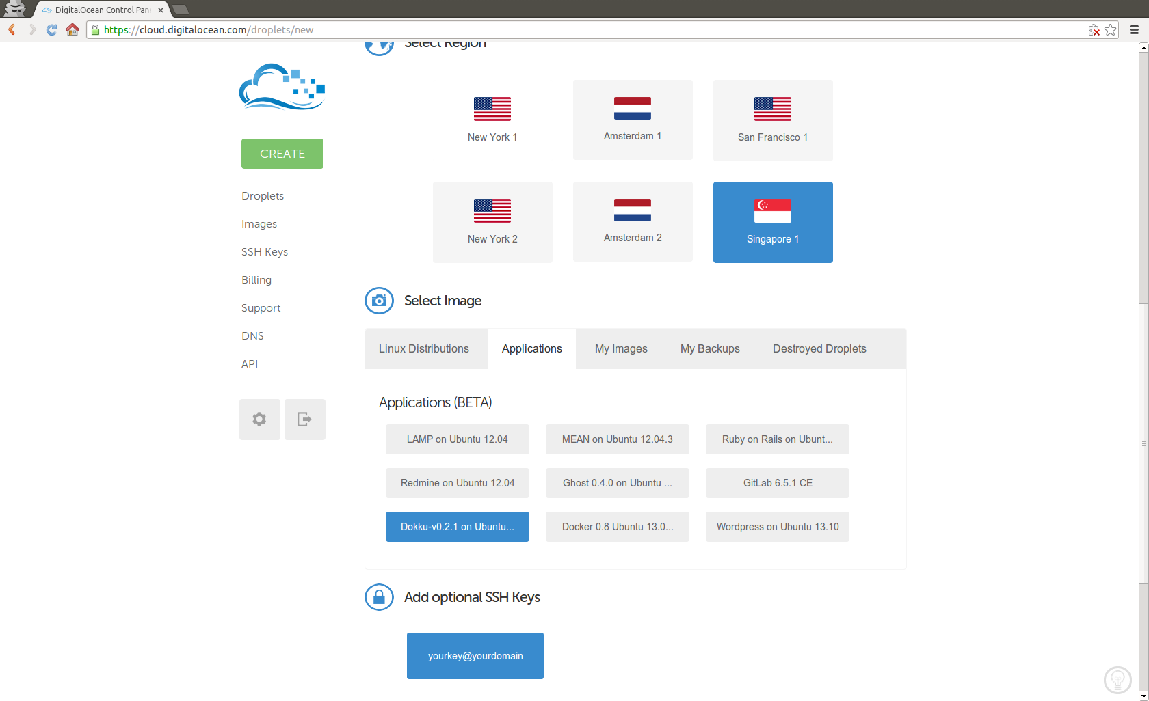
Dokku server setup - Option 1
Option 1: Spin up a Dokku instance on DigitalOcean
Notes:
* Dokku is available as option on DigitalOcean
* Prior Dokku version (as of today)
* Remember the ssh keys

Slide 36

Dokku server setup - Option 2
Option 2: Take the scenic route
# Ubuntu 12.04/12.10/13.04 (13.10 not supported), run*:
$ wget -qO- http://goo.gl/mUoUcq | sudo DOKKU_TAG=v0.2.2 bash
# Debian 7 (Wheezy), run* (as root):
$ wget -O- http://goo.gl/Sa3ndL | bash
$ wget -qO- http://goo.gl/mUoUcq | sudo DOKKU_TAG=v0.2.2 bash
* No warranties, no liability
Watch @ Shelr.tv
http://bit.ly/dokku-2014-03-shelr-install-dokku-server

Slide 37

Dokku client setup/push
Create apps with git remote, deploy with git push
# Add developer’s public key to dokku@<DOKKU_SERVER>
$ cat ~/.ssh/id_rsa.pub | ssh root@<DOKKU_SERVER> “sudo sshcommand acl-add dokku <NICKNAME>”
# For each local repo, add <DOKKU_SERVER>:<APP_NAME> target
$ git remote add dokku dokku@<DOKKU_SERVER>:<APP_NAME>
# Deploy from a local branch
$ git push dokku master # can be master, new-feature, etc.
Watch @ Shelr.tv
http://bit.ly/dokku-2014-03-shelr-dokku-client-push

Slide 38
Dokku commands
# run commands directly on server
$ ssh root@<DOKKU_SERVER>
root@<dokku_server>$ dokku <command>
# or run via ssh tty
$ ssh -t dokku <command>
# pro-tip: no command, no result
$ dokku
$
# display help
$ dokku help
# display stdout of web app
$ dokku logs <app>
# set env vars for the web app
$ dokku config:set <app> <env_var> <value>
# delete web app container
$ dokku delete <app>

Slide 39



Dokku + Continuous Integration
DOKKU + YOUR CI TOOL = CONTINUOUS DELIVERY
Notes:
continuous delivery = automation of dokku

Slide 40
Deploy via Docker images
# commit app to private Docker repository via Docker
$ docker commit <APP_HASH> app_<VERSION>
# deploy on production servers/cloud
$ docker run <PRIVATE_REPO>
to create your own private repo, see: https://blog.codecentric.de/en/2014/02/docker-registry-run-private-docker-image-repository/
Notes:
finally, from there, you can snapshot those running containers and deploy them as Docker images

Slide 41
6
APP DEPLOY RELOADED

Slide 42
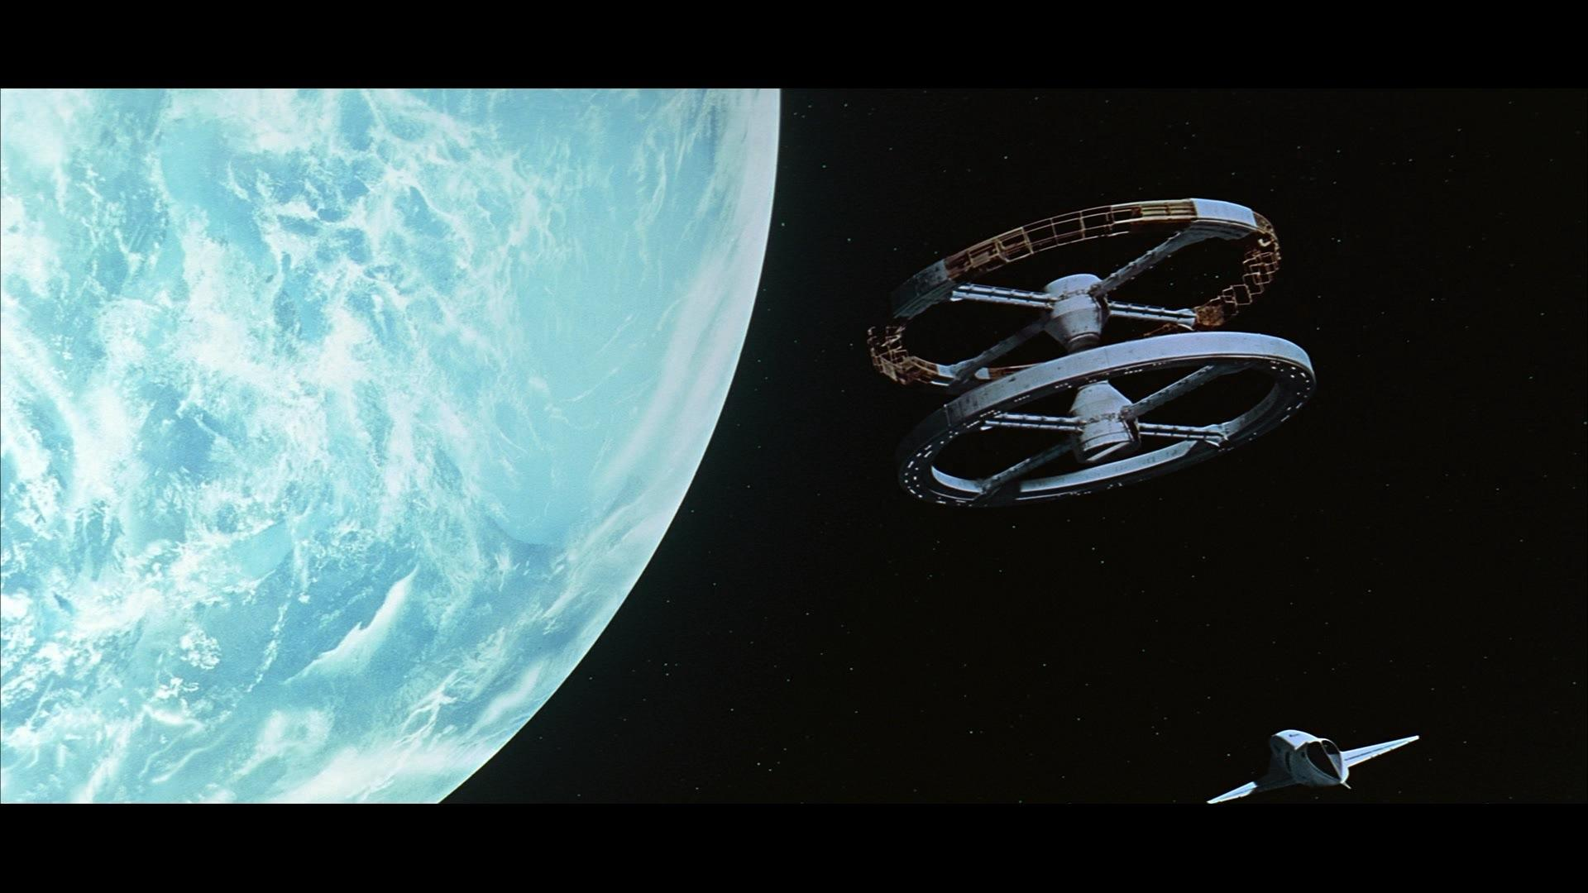
LIFE AFTER DOKKU

Slide 43
LAUNCH DAY
RE-launch

Slide 44
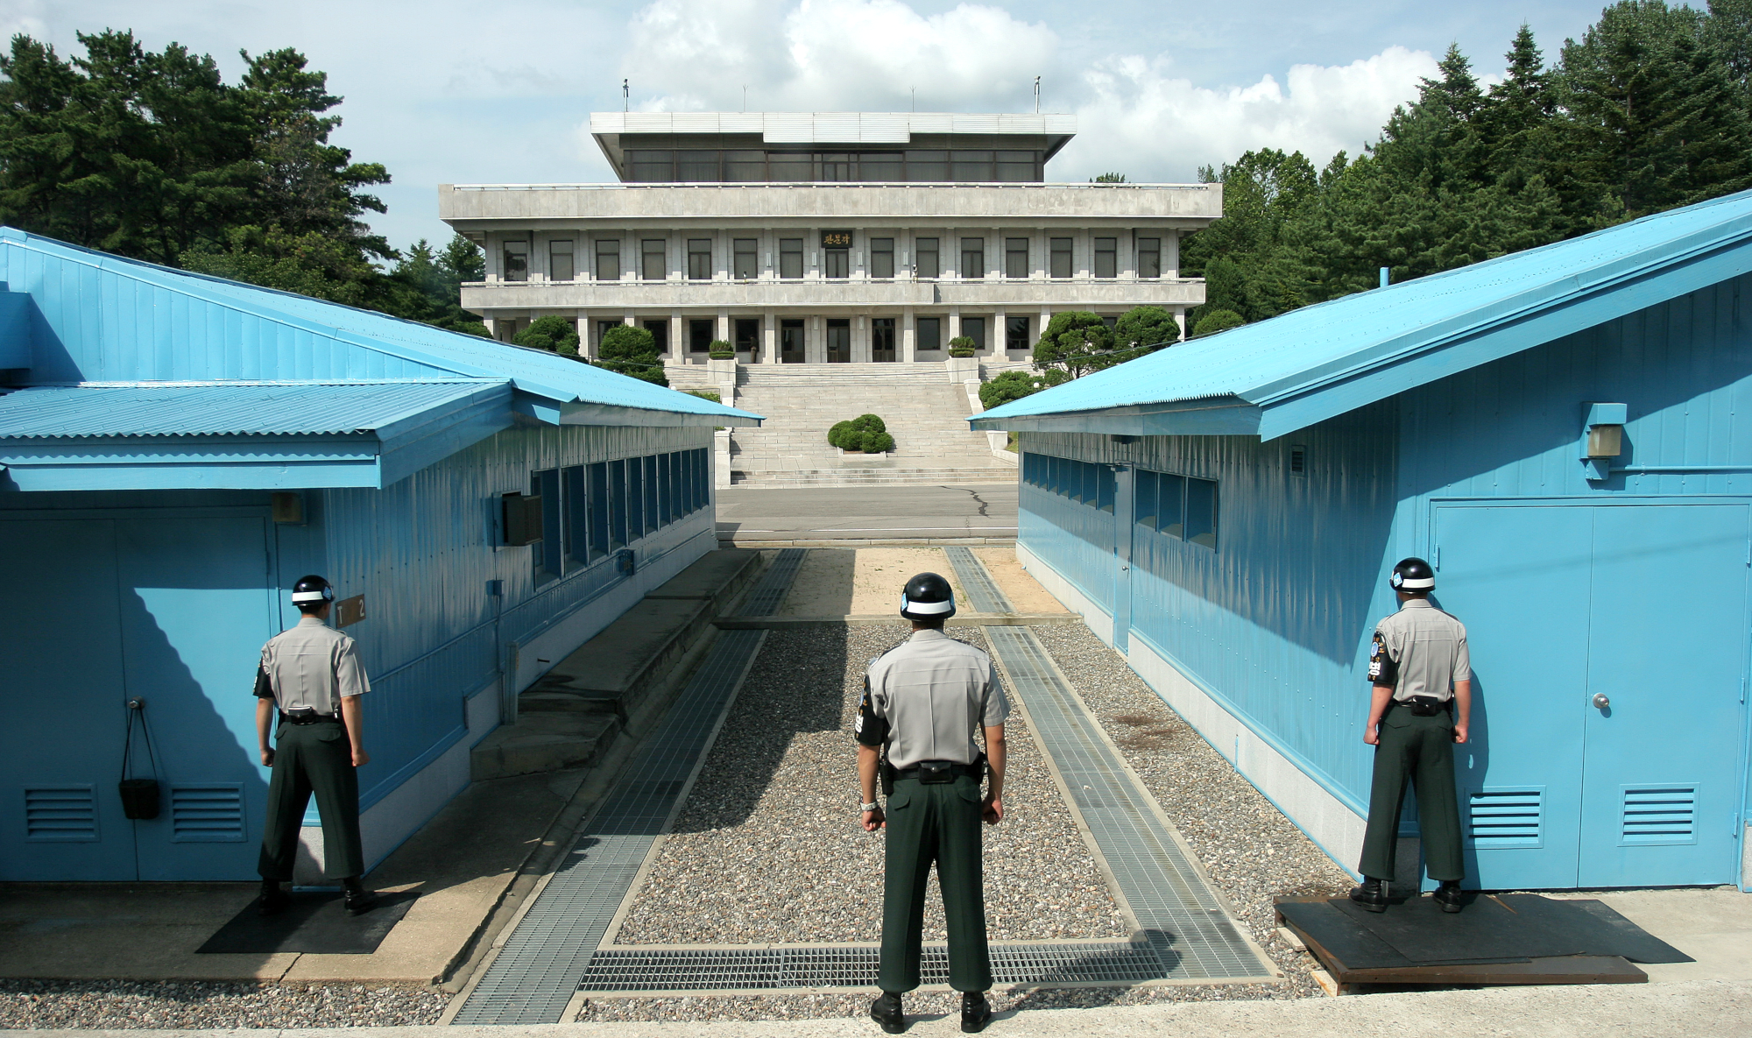
ALL QUIET ON THE OPS FRONT
Notes:
all quiet on the DMZ front

Slide 45
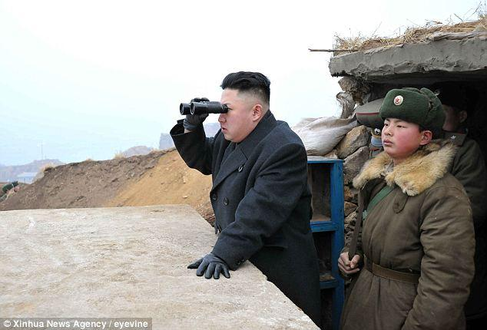
DEPLOY!
Notes:
and now you gather the whole team together and… DEPLOY!

Slide 47

#PROFIT

Slide 48
7
RESOURCES

Slide 49
Try It, Learn It
Try It
Install Dokku on your own servers, or
Spin up an instance from DigitalOcean
Learn It
Dokku Homegithub.com/progrium/dokku
Digital Ocean Tutorial
http://bit.ly/dokku-2014-03-ref
Google
http://lmgtfy.com/?q=Dokku

Slide 50
Presentation Links
http://bit.ly/dokku-2014-03 (this presentation)
http://bit.ly/dokku-2014-03-shelr (shell recording)
http://bit.ly/dokku-2014-03-src (source code)
http://bit.ly/dokku-2014-03-links (all links)

Slide 51
Credits
Heroku logo:https://d1lpkba4w1baqt.cloudfront.net/heroku-logo-light-300x100.png
Git logo: http://git-scm.com/images/logos/downloads/Git-Logo-2Color.png
Docker logo: https://www.dotcloud.com/static/img_2012/docker_logo.png
Cloudbees logo: http://kohsuke.org/wp-content/uploads/2011/03/CloudBees-Logo.png
Nginx logo: http://wiki.nginx.org/images/8/83/Nginx-logo.svg
Kim Jung Il at computer: http://kimjongunlookingatthings.tumblr.com/image/46612145368
Psy Screencaps:
http://s12.photobucket.com/user/jcwc84/media/PSY-GANGNAMSTYLEM_Vmp4_snapshot_0108_20110903_170334-1.jpg.html
Kim Jung Il clapping: http://media.zenfs.com/en_us/News/Reuters/2014-02-10T164111Z_1452424685_GM1EA2B014301_RTRMADP_3_KOREA-NORTH.JPG
2001 Space Odyssey:
Dawn of Man: http://www.flavinscorner.com/2001bone.jpg
Cut scene: http://www.muenster.org/filmwerkstatt/filmfestival/15/english/match-cut.jpg
N. Korean Mass Games: https://upload.wikimedia.org/wikipedia/commons/1/1b/Arirang_Mass_Games,_Pyongyang,_North_Korea-1.jpg
N. Korean Mass Games: https://farm9.staticflickr.com/8054/8110300895_0075042080_o.jpg
Korean DMZ: https://upload.wikimedia.org/wikipedia/commons/7/72/A_South_Korean_soldier_(right)_stands_guard_at_Pan_Mun_Jom_in_Korea's_Demilitarized_Zone_Sept_020912-F-IZ313-223.jpg
Korean DMZ https://upload.wikimedia.org/wikipedia/commons/e/ed/Panmunjeom_DMZ.png

Slide 52
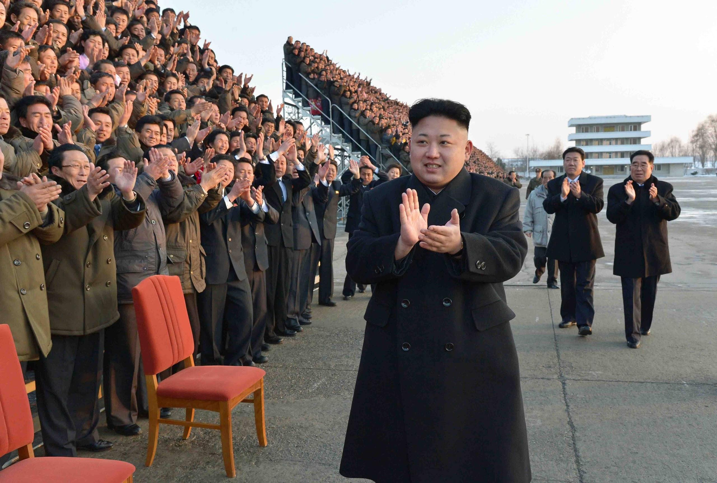
THANK YOU!

